Slide 1
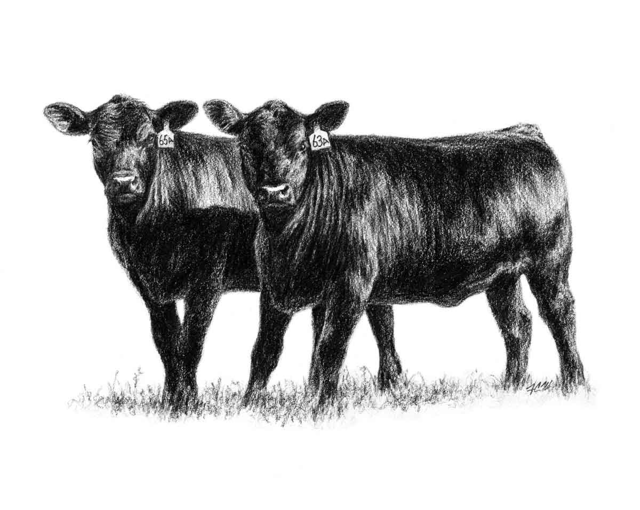

AgViz Data Visualization Tool
A web application that visualizes climate change
to aid sustainable practices in livestock production
Gemini
Matt, Nani, Ryan and Roosevelt
Photo credit: http://cahnrs.wsu.edu/fs/wp-content/uploads/sites/4/2014/11/ClubCalfSale.jpg

Slide 2
Overview
Client requests
System requirements
State of the project
Future work
Project schedule

Slide 3
Client requests

Slide 4
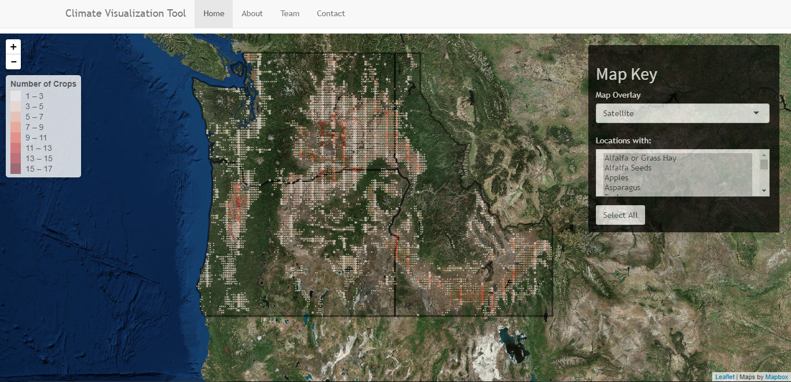

Slide 5
System requirements

Slide 6
Functional requirements
Splash page
Map
Zoom
Data Points
Legend
Menu
Indicators
Boundaries
Overlay
Climate Models
Time Period
Data view page
Food supply
Net Production
Forage Variability
Inedible : Edible Plants
Heat Stress
Aggregate
Notes:
Requirements:
Since we are building an addition to a system that is already in use, we were asked to make it look and feel like the old system.
So we were asked to include all of these features plus a couple that are unique to our app.
To make it look and feel like the old system we also had a few nonfunction quality requirements and constraints on how to implement

Slide 7
Non-functional requirements
Quality Requirements
User design
Load times
User help
Indicator descriptions
Browser compatibility
User interface
Resolution of visuals
Color scheme and font
Implementation Constraints
Development tools
R language
Shiny
Leaflet
Data files
File format

Slide 8
State of the project

Slide 9
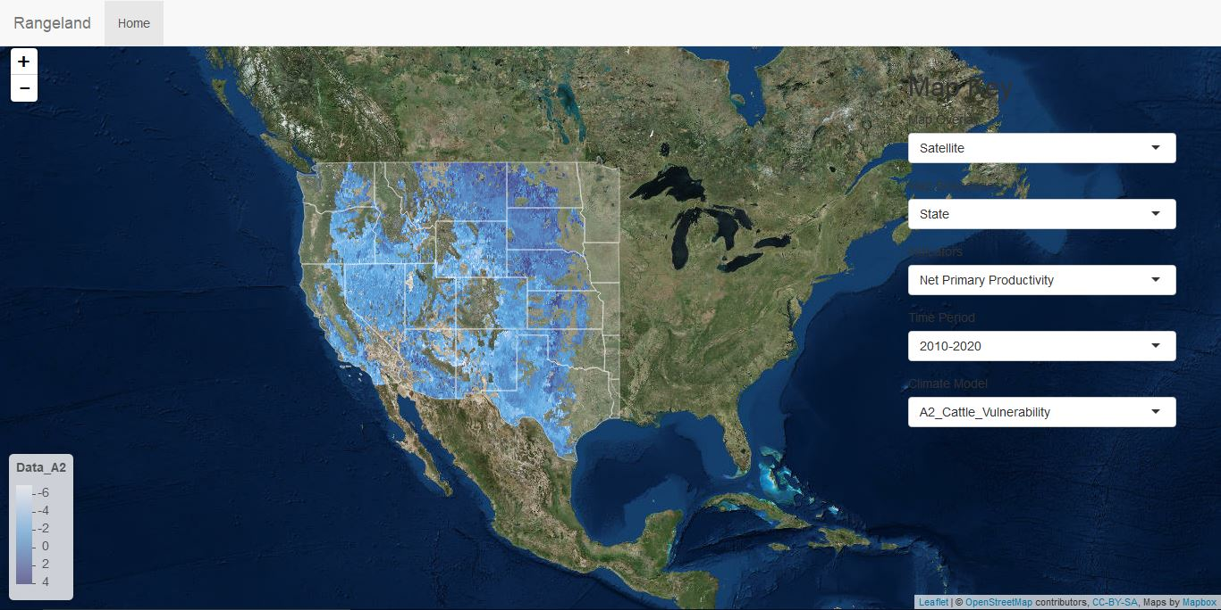
Splash page
Map
Zoom
Data Points
Legend
Menu
Indicators
Boundaries
Overlay
Climate Models
Time Period

Slide 10
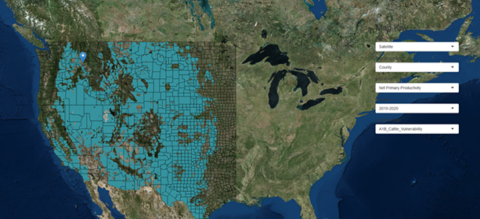
Boundaries
Boundaries
State
County
Congressional District

Slide 11
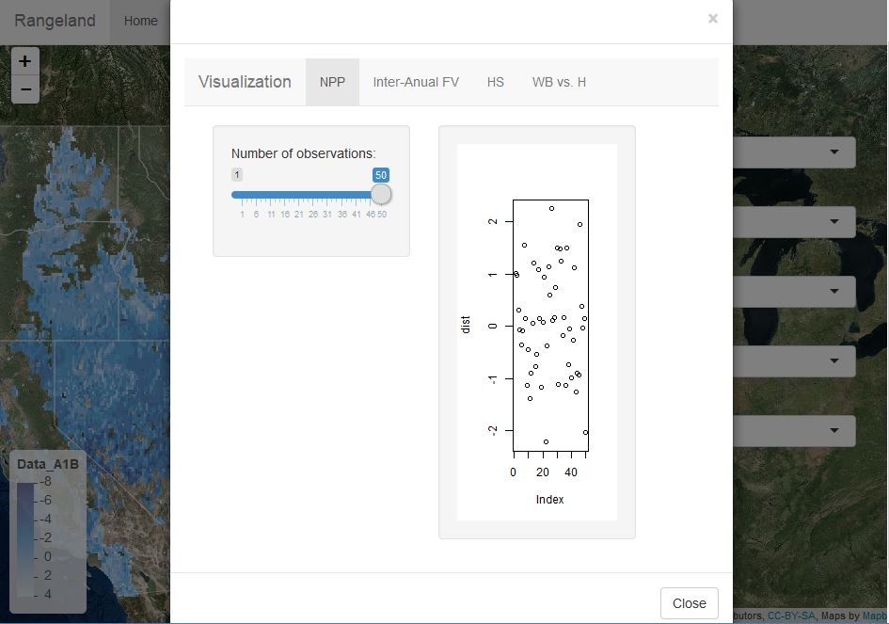
Data view page
Food supply
Net Production
Forage Variability
Inedible : Edible Plants
Heat Stress
Aggregate
Screenshot of plot here

Slide 12
Future Work

Slide 13
Future Work
Incorporate New Dataset
Plot Indicators
Indicators Descriptions
Produce User Help Tutorial
Test Browser Compatibility
Performance Optimization
Refactor Design
Parse Data
Determine Hardware Requirements
Integrate with previous teams work

Slide 14
Project Schedule

Slide 15
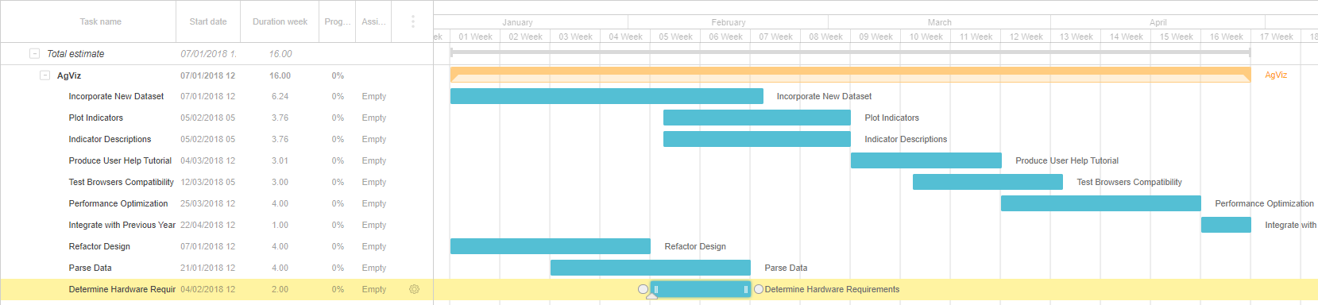
Project schedule

